Slide 1
Name: Mahesh Kumar Pratihar Supervisor: Assoc. prof. dr. Pavel Stefanovič
Textual Data Clusterization Based on Self-organizing Maps and Word Embeddings

Slide 2
Problem:
Various text data preparation algorithms exist, such as text2vector, a bag of words, a bag of n-grams, and the most popular word embedding models. In this topic, the main task will be to take different characteristics datasets that are already classified and use the SOM to cluster results as well as possible.

Slide 3
The main aim of the work, tasks
Aim:
Finding datasets, cleaning them using python and perform experimentation using python and orange data mining.
Tasks:
Getting datasets.
Cleaning datasets.
Trying initial experimentation with python and orange mining.

Slide 4
Datasets
Source | Context | Name | Row number | Classes
(Hillary Clinton and Donald Trump Tweets, n.d.) | Tweets of Hillary Clinton and Donald Trump for the 2016 US Presendential Election. | Hillary Clinton and Donald Trump Tweets | 3000 | 2
(Pang & Lee, 2004) | Positive and negative reviews of movies | Polarity_dataset_v2.0 | 2000 | 2
(AG’s Corpus of News Articles, n.d.) | News Articles | AG | 1127918 | 14
(Bose, 2019) | BBC News articles | BBC News | 1490 Training, 735 Test | 5
(Twitter Sentiment Analysis, n.d.) | Entity-level sentiment analysis dataset of twitter | Tweets | 74682 | 3
(Almeida et al., 2011) | SMS are tagged ham(legitimate) or spam | SMS Spam | 5573 | 2

Slide 5
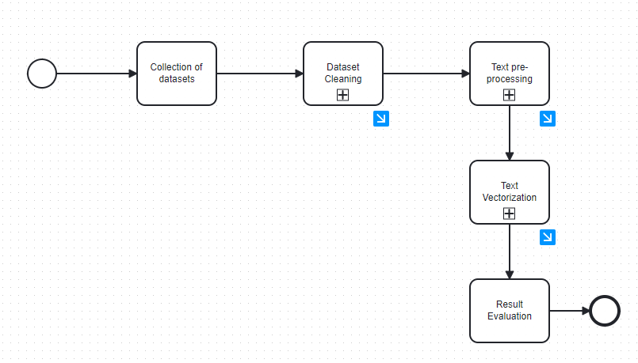
MAIN PROCESS

Slide 6
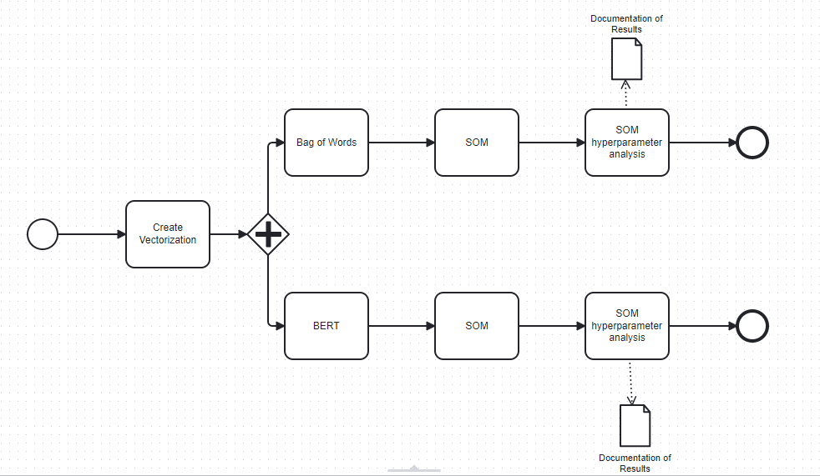
SOM sub-process

Slide 7
Initial Experimentation Results using python
Metric | Description
Neuron Count | 100 (10x10 grid), each position in the grid.
U-Matrix Visualization | Showed clear topological distances between clusters.
Label Purity Heatmap | Used to inspect how cleanly neurons captured single-class labels.
Average Neuron Purity | ~0.79 (example, real value depends on data)
Best Purity | 1.0 (pure neurons – only one label type)
Worst Purity | ~0.50 (fully mixed neurons)
Adjusted Rand Index (ARI) | Comparing predicted clusters to true labels, 1: perfect clustering, 0: random labelling, <0: discordant clustering
Silhouette Score | Evaluates how distinct clusters are, 1: well, separated, 0: overlapping clusters, -1: wrong clustering

Slide 8
Metrics Results
Metric | Description | Value
Cluster Purity | Avg. % of dominant label per neuron, higher values imply better separation by true class labels. | 0.7875, not bad, but some neurons clearly mix classes.
Adjusted Rand Index (ARI) | Compares clustering to true labels | 0.0109, close to random assignment of classes, need improvement (may be change the BERT model)
Silhouette Score | Measures intra vs. inter-cluster separation | -0.0005, points are not well separated, input embedding might not be semantically strong.

Slide 9
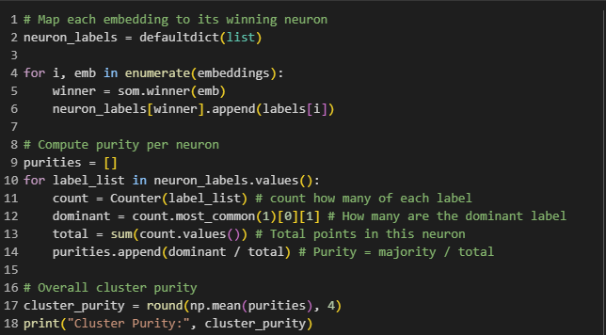
Cluster Purity - google colab - tweets analysis

Slide 10
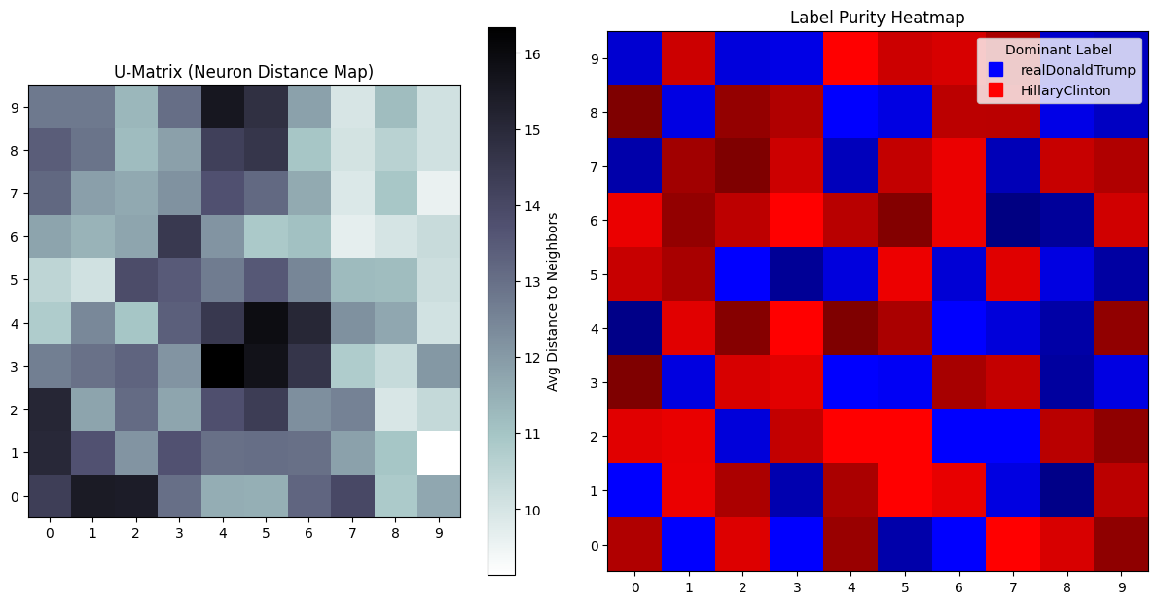
Graphs U-matrix and Label Purity Heat Map

Slide 11
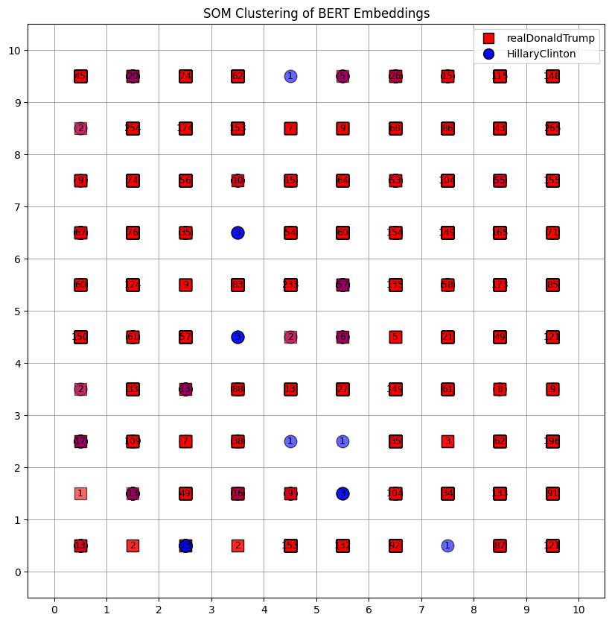
Graphs- SOM clustering

Slide 12
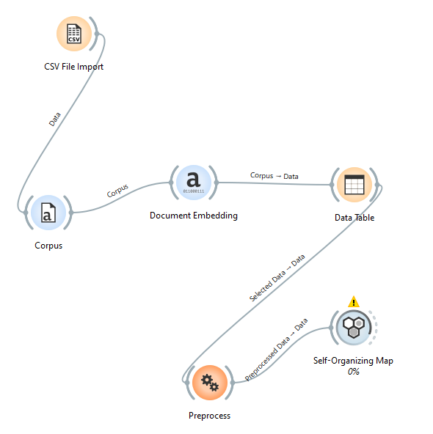
ORANGE DATA MINING

Slide 13
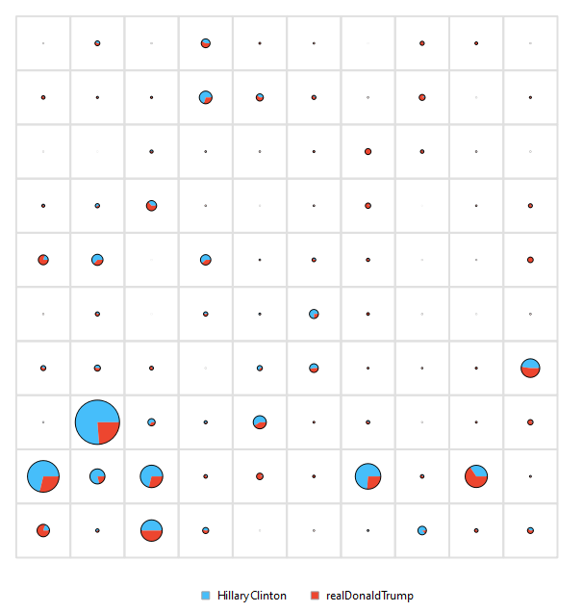
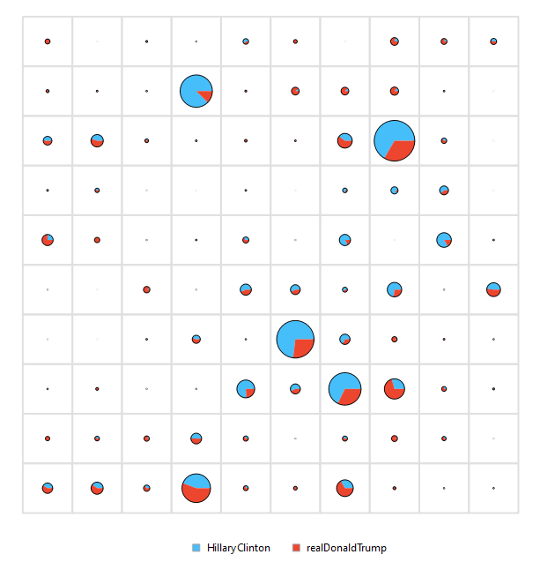
SOM results for tweets using Orange

Slide 14
Discussion on technological background
SOMs frequently combined with advanced word embedding models (Word2Vec, GloVe, BERT) to capture richer contextual relationships.
Hybrid models: Integration of SOMs with Generative Adversarial Networks (GANs) or hierarchical approaches for improved performance.
Datasets Used:
Pre-labeled multilingual text corpora like:
News datasets (e.g., AgNews, Romanian LaRoSeDa).
Domain-specific datasets (e.g., financial news, product reviews).
Social media datasets (e.g., Twitter for topic modeling and sentiment analysis).
High-dimensional synthetic or benchmark datasets for validation.
Proposed Dataset:
A labeled English dataset will serve as the foundational corpus, ensuring alignment with the research aim.
Augmented by synthetic datasets or standard multilingual corpora to evaluate scalability and adaptability of the model.

Slide 15
Plan for next semester
Trying to find a tool for training of SOMs
Cleaning and pre-processing.
Hyperparameter checking.

Slide 16
Questions, suggestions?

